Slide 1
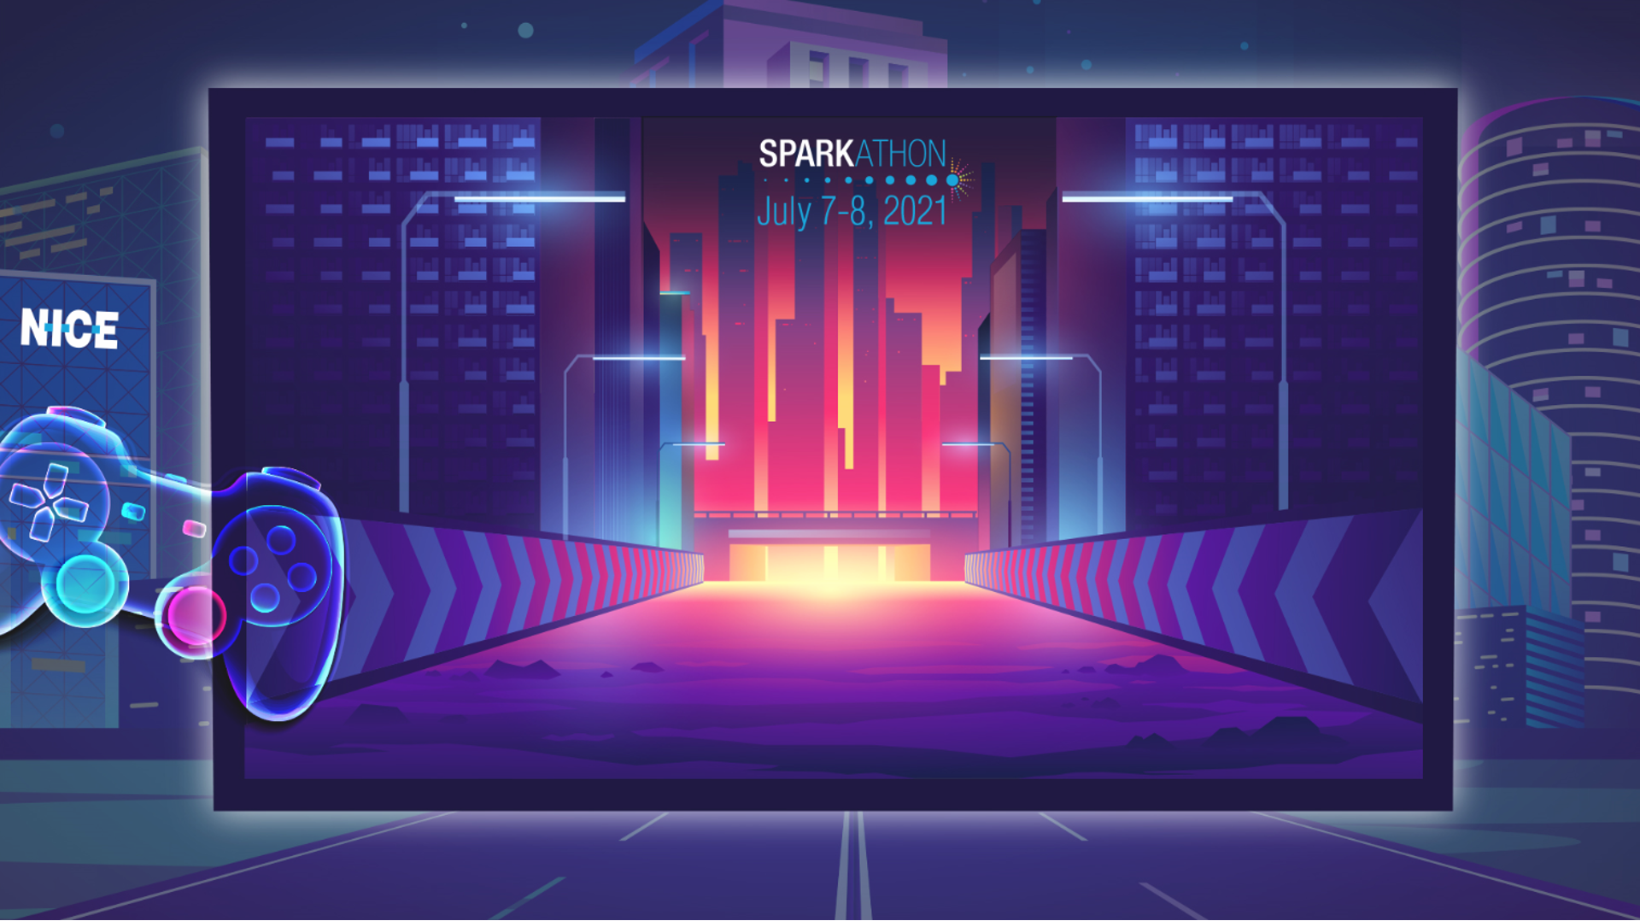
Enhance ACD API Consumer Experience

Slide 2










Team Revitalizers (a.k.a. THE A-Team)
Amit Ugane
Enrique Ortuno Rios
Mangesh Ghormode
Harshal Dhake

Slide 3

ACD API(s) are monolith and not microservices. We do follow API First approach which is great, however there are few challenges with our current API design as suggested below.
High Network traffic.
Over Fetching OR Under Fetching.
API Versioning.
Documentation.
Lack of Future Proofing for Adoption of Microservices Architecture.

Slide 4

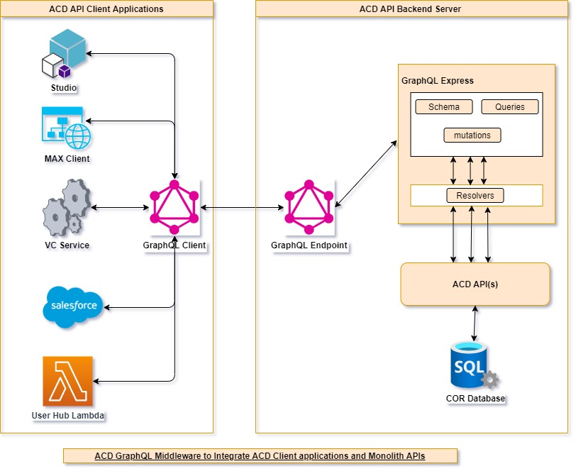
We are proposing usage of GraphQL , a query language for API, and a server-side runtime for executing queries using a typed system you define for your data

Slide 5

Below are some of the value additions we will get by adding GraphQL Middleware
Better Customer Engagement
Elegant & Efficient data Retrieval == Performance
Fine-Grained Caching == More Performance
Maintenance Cost Reduction
Self Documentation
Easier Versioning
Strongly Typed System == Less Bugs
Agility
Quicker Feature Turnaround
Faster Developer Output
Technology Integration
Future Centric
Better Productivity
Developer & DevOps Tools == Happier Developers
Refer to slide #8 & #10 for more details on challenges and impact from technology perspective.

Slide 6

GitHub Repo - https://github.com/amit-ugane-incontact/acd-graphql-sparkathonpoc.git (Main Branch)
For the demo, we have combined below use cases
VC – Calling Agents and Agent Settings one after the other. We have combined both Agent and Agent Settings APIs with one Graphql Query
Salesforce – Calling Skills API followed by retry-settings / schedule-settings APIs.
Due to time limitation, we haven’t made changes into VC / Salesforce, but we are demoing from graphql query editor in browser with the call these clients would make instead of too many API Calls.
POC is talking to staging APIs with a pre-generated auth token.

Slide 7


Slide 8
ACD API(s) are monolith and not microservices. We do follow API First approach which is great, however there are few challenges with our current API design as suggested below.
ACD API consumers are invoking multiple endpoints over the network to present a certain piece of information.
For example, Whenever Agent logs in we are calling get agents followed by Agent Settings which is used further to setup agent workflows in VC service.
Or when salesforce needs to find out skills information along with retry-settings, schedule-settings, it first gets all skills and then makes calls to each setting APIs one after the other.
This is a well adopted pattern however why to make multiple roundtrips from client to server instead get all the necessary date by invoking a single endpoint and reduce overall network traffic.
With our API First approach, we either send back too much data or not enough of it. This is clearly an over-and under fetching problem.
For example , in the same example above whenever salesforce client gets skills information, it is only interested in few fields versus 69 fields we are sending in the response.
﻿Other problem is API versioning, every time we create a new version, and add a redundant code, update version and publish. It is leading to a lot of tech debt and potential code traceability and maintenance issues.
For Documentation, we define and maintain a separate schema and a separate team that generates proxy types from schema to generate documentation. This is a lot of effort and infrastructure maintenance.
From future vision of breaking monolith into microservices perspective, we would also require a lot of changes in client applications if/when we start creating newer microservice to provide domain driven functionality to API consumers.

Slide 9
We are proposing usage of GraphQL , a query language for API, and a server-side runtime for executing queries using a typed system you define for your data
GraphQL Middleware Tech specification
graphql-yoga : Fully-featured GraphQL Server with focus on easy setup, performance and great developer experience https://github.com/dotansimha/graphql-yoga.git
graphql.js : The reference implementation of the GraphQL specification, designed for running GraphQL in a Node.js environment.
@babel/cli : Command Line Interface wherein, the JavaScript code can be easily compiled to the respective ECMA Script using easy to use commands
Note : For POC we have chosen graphql-yoga, however it can be substituted with alternatives such as
Express GraphQL: The reference implementation of a GraphQL API server over an Express webserver. You can use this to run GraphQL in conjunction with a regular Express webserver, or as a standalone GraphQL server.
Apollo server : A set of GraphQL server packages from Apollo that work with various Node.js HTTP frameworks (Express, Connect, Hapi, Koa etc).
AWS Amplify : A JavaScript library for application development using cloud services, which supports GraphQL backend and React components for working with GraphQL data.
AWS AppSync is a fully managed AWS service that makes it easy to develop GraphQL APIs.
We plan to take this idea forward with an ADR, to do a deep evaluation of each of these alternatives, in order to come to a right technology selection.

Slide 10
Below are some of the value additions we will get by adding GraphQL.
Fetching data with a single API call. The GraphQL and existing REST APIs is that the latter is centered around individual endpoints, so to collect all needed data, at client side we need to combine multiple endpoints. Whereas GraphQL focuses on the task itself, in this case, we can request the needed data with just one API call.
No over- and under-fetching problems. Existing API responses are known for either containing too much data or not enough of it, creating the need for another request. GraphQL solves this efficiency problem by fetching the exact data in a single request.
Tailoring requests as per needs. As it was mentioned, REST API documentation explains individual endpoints, their functions, and the parameters can be passed to them. Describing the data types, fields, and the interaction points between them, GraphQL API provide ability to tailor the request to get the information that is needed.
Validation and type checking out-of-the-box. GraphQL’s introspection feature allows for navigating into the types and discovering the schema to ensure client applications only ask for what’s possible and in the appropriate format. That said, we can see what the schema can query and how the data is set up there. Based on that, we can easily add new fields to existing queries through a GraphQL IDE. There’s no need to validate the data format, as GraphQL does it for you. We would need only to write resolvers – how the data will be received.
Autogenerating API documentation. GraphQL keeps documentation in sync with API changes. As the GraphQL API is tightly coupled with code, once a field, type or query changes, so do the docs. This directly benefits API Documentation team, since they will be able to spend less time documenting an API.
API evolution without versioning. GraphQL eliminates the need for versioning by deprecating APIs on a field level. Aging fields can be later removed from the schema without impacting the existing queries. GraphQL enables that by creating a uniform API across the entire application that isn’t limited by a specific storage engine. By using a single, evolving version, GraphQL APIs give apps continuous access to new features and encourage cleaner, more maintainable server code.
Good fit for ACD Monolith APIs and Future Migration to Microservices. By integrating multiple systems behind its API, GraphQL unifies them and hides their complexity. The GraphQL server is then responsible for fetching the data from the existing systems and packaging it up in the GraphQL response format. When migrating to a microservice architecture, a GraphQL API can help handle communication between multiple microservices by merging them into one GraphQL schema. While each microservice defines its own GraphQL schema and has its own GraphQL endpoint, one GraphQL API gateway consolidates all schemas into one global schema.

